Slide 1
REGRESSION
Machine Learning
BS-AI 007
Muhammad Wahaaj Siddique

Slide 2
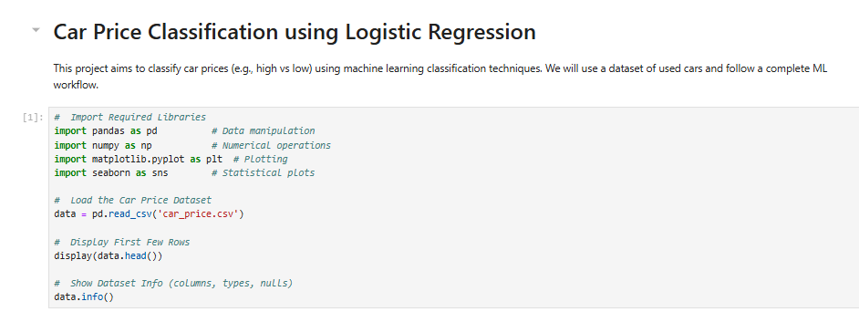
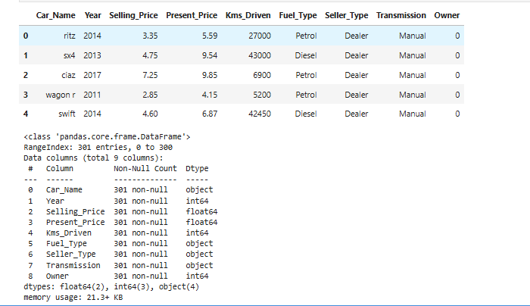
STEP # 1

Slide 3

STEP # 2

Slide 4
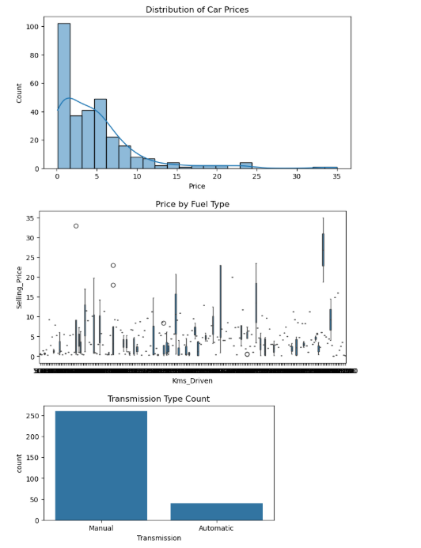
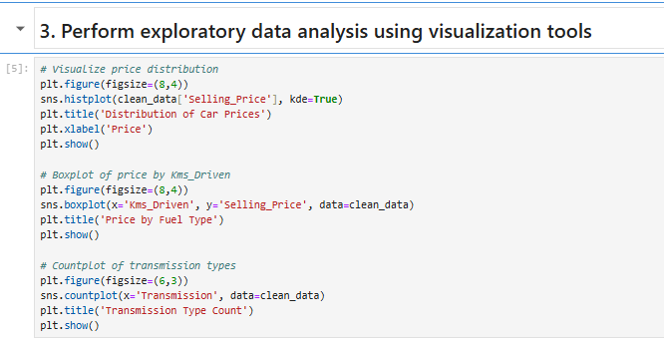
STEP # 3

Slide 5
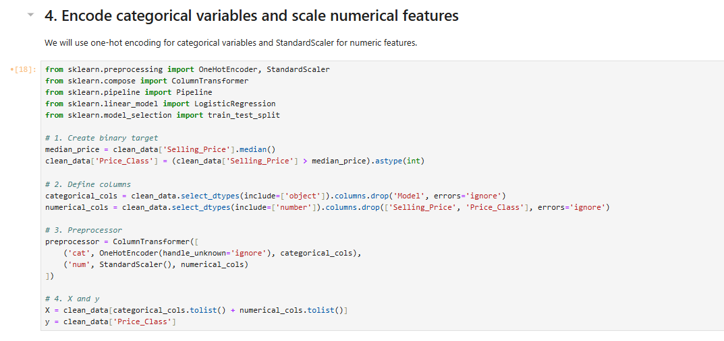
STEP # 4

Slide 6
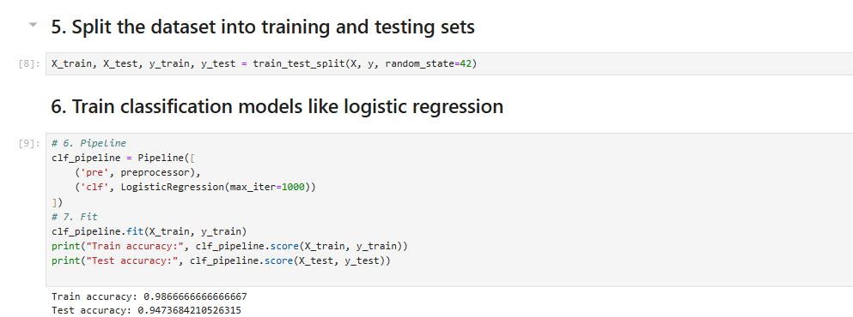
STEP # 5 & 6

Slide 7

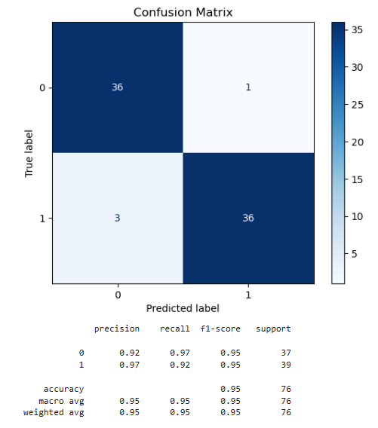
STEP # 7

Slide 8

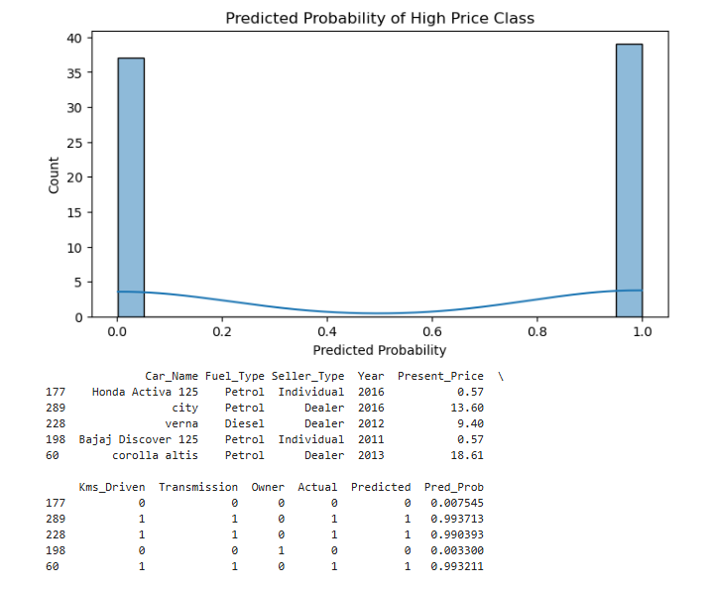
STEP # 8

